Slide 1
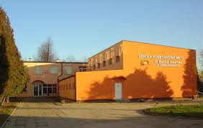
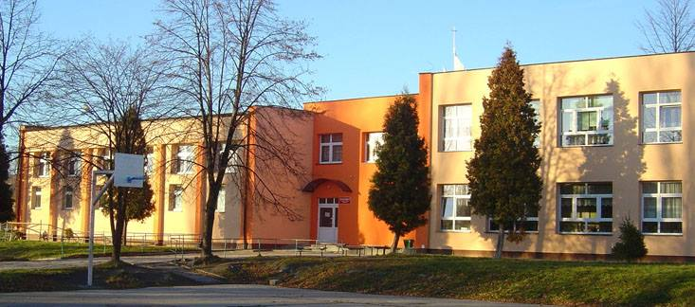
POLISH PRIMARY SCHOOL

Slide 2
HISTORY
In 1970 our school was opened. On May 24, 1971, the school was given the name of Nicolaus Copernicus. On May 24, 1972, the scout tribe received the name of the conquerors of space. In 2000 a European club was created. our school is an eight-year school. In addition to lessons, we organize green schools, interest groups and trips. All students learn English from the first grade. Zygmunt Biskup was the first director.

Slide 3
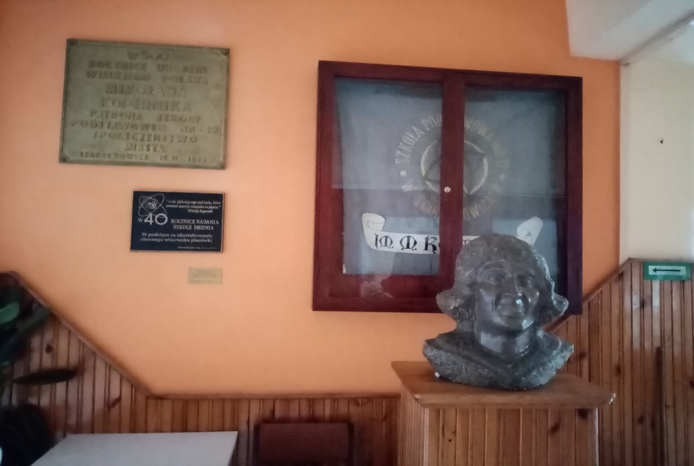
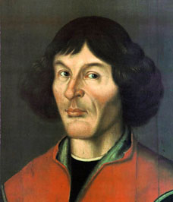
OUR PATRON

Slide 4
Nicolaus Copernicus was born in 1473. He was an astronomer from Poland, Toruń. He was a Renaissance-era polymath, who formulated a model of the universe that placed the Sun rather than Earth at the center of the universe. Copernicus was born and died in Royal Prussia, a region that had been part of the Kingdom of Poland since 1466. His father was a merchant from Kraków and his mother was the daughter of a wealthy Toruń merchant. Nicolaus was the youngest of four children. Copernicus is postulated to have spoken Latin, German, and Polish with equal fluency. He also spoke Greek and Italian and had some knowledge of Hebrew. Having completed all his studies in Italy, 30-year-old Copernicus returned to Warmia, where he would live out the remaining 40 years of his life, apart from brief journeys to Kraków and to nearby Prussian cities. His administrative and economic duties did not distract Copernicus, in 1512–15, from intensive observational activity. The results of his observations of Mars and Saturn in this period, and especially a series of four observations of the Sun made in 1515, led to discovery of the variability of Earth's eccentricity and of the movement of the solar apogee in relation to the fixed stars, which in 1515–19 prompted his first revisions of certain assumptions of his system. Copernicus spent the jubilee year 1500 in Rome, where he arrived with his brother Andrew that spring, doubtless to perform an apprenticeship at the Papal Curia. Toward the close of 1542, Copernicus was seized with apoplexy and paralysis, and he died at age 70 on 24 May 1543.

Slide 5
TIMETABLE 6B
MONDAY | TUESDAY | WEDNESDAY | THURSDAY | FRIDAY
Education for Family Life | PE |  | Polish | PE
Maths | Polish | PE | Religious Studies | Music
Polish | Polish | Biology | English | Polish
Hour with Tutor | Maths | Religious Studies | History | Maths
IT | Geography | IT | Math | Art
English | History | English
PE

Slide 6
CLASROOM S AND ROOMS AT SCHOOL
In our school we have a gym with a cloakroom and three sport fields outside. You can play basketball, volleyball and football there. We also have two playgrounds, on one of them you can play, and on the other you can learn. Inside the school we have many classrooms. One of the parts is dedicated to the younger children 0-3, and the second one is for the older kids and teens (4-8). On the first floor we have a common room and a canteen with a play room. There is also a secretary and and a locker-room. On the second floor you have a nurse’s office, teachers’ room and a library.

Slide 7
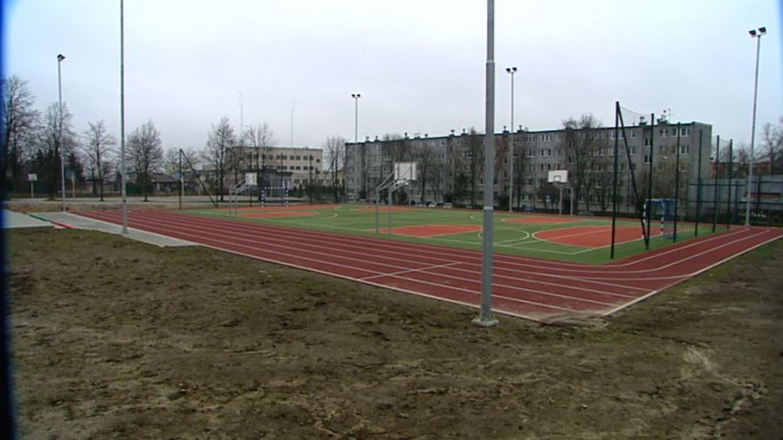
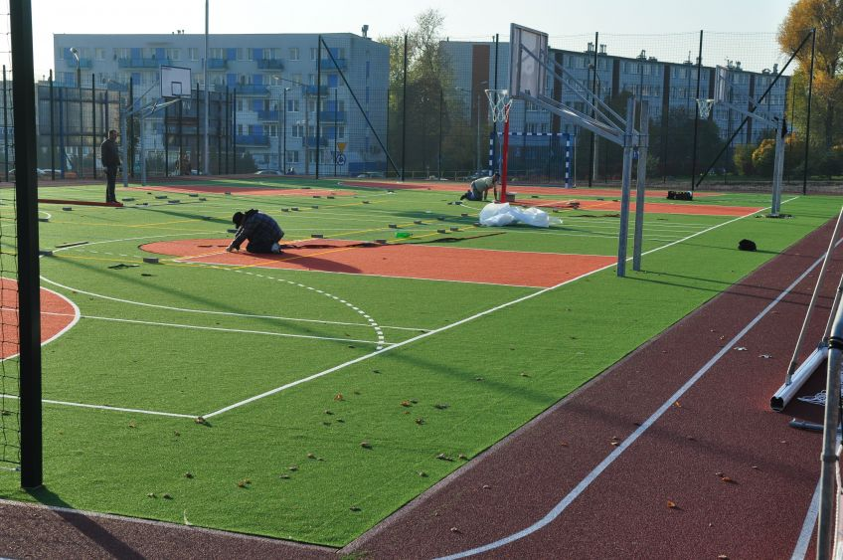
SPORTS
FIELDS

Slide 8
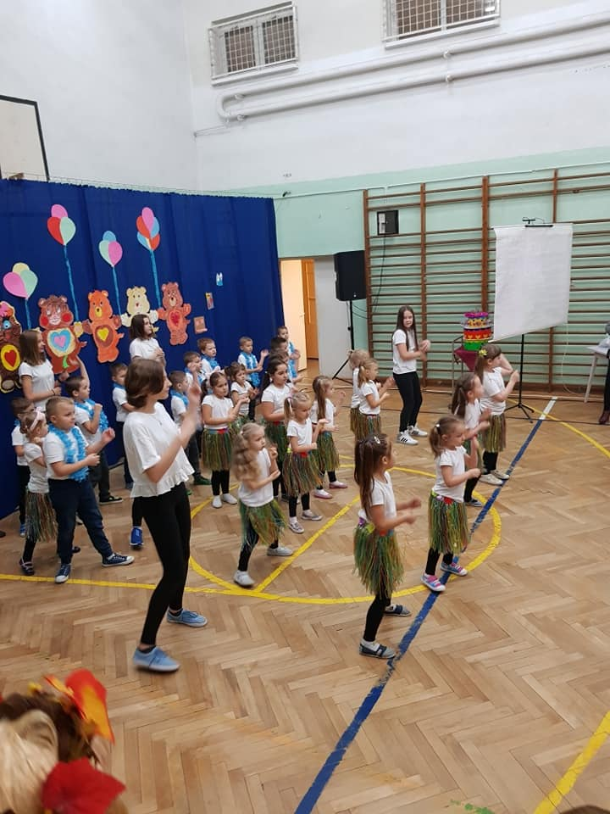
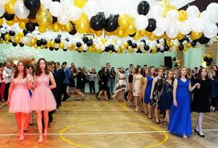
GYM

Slide 9
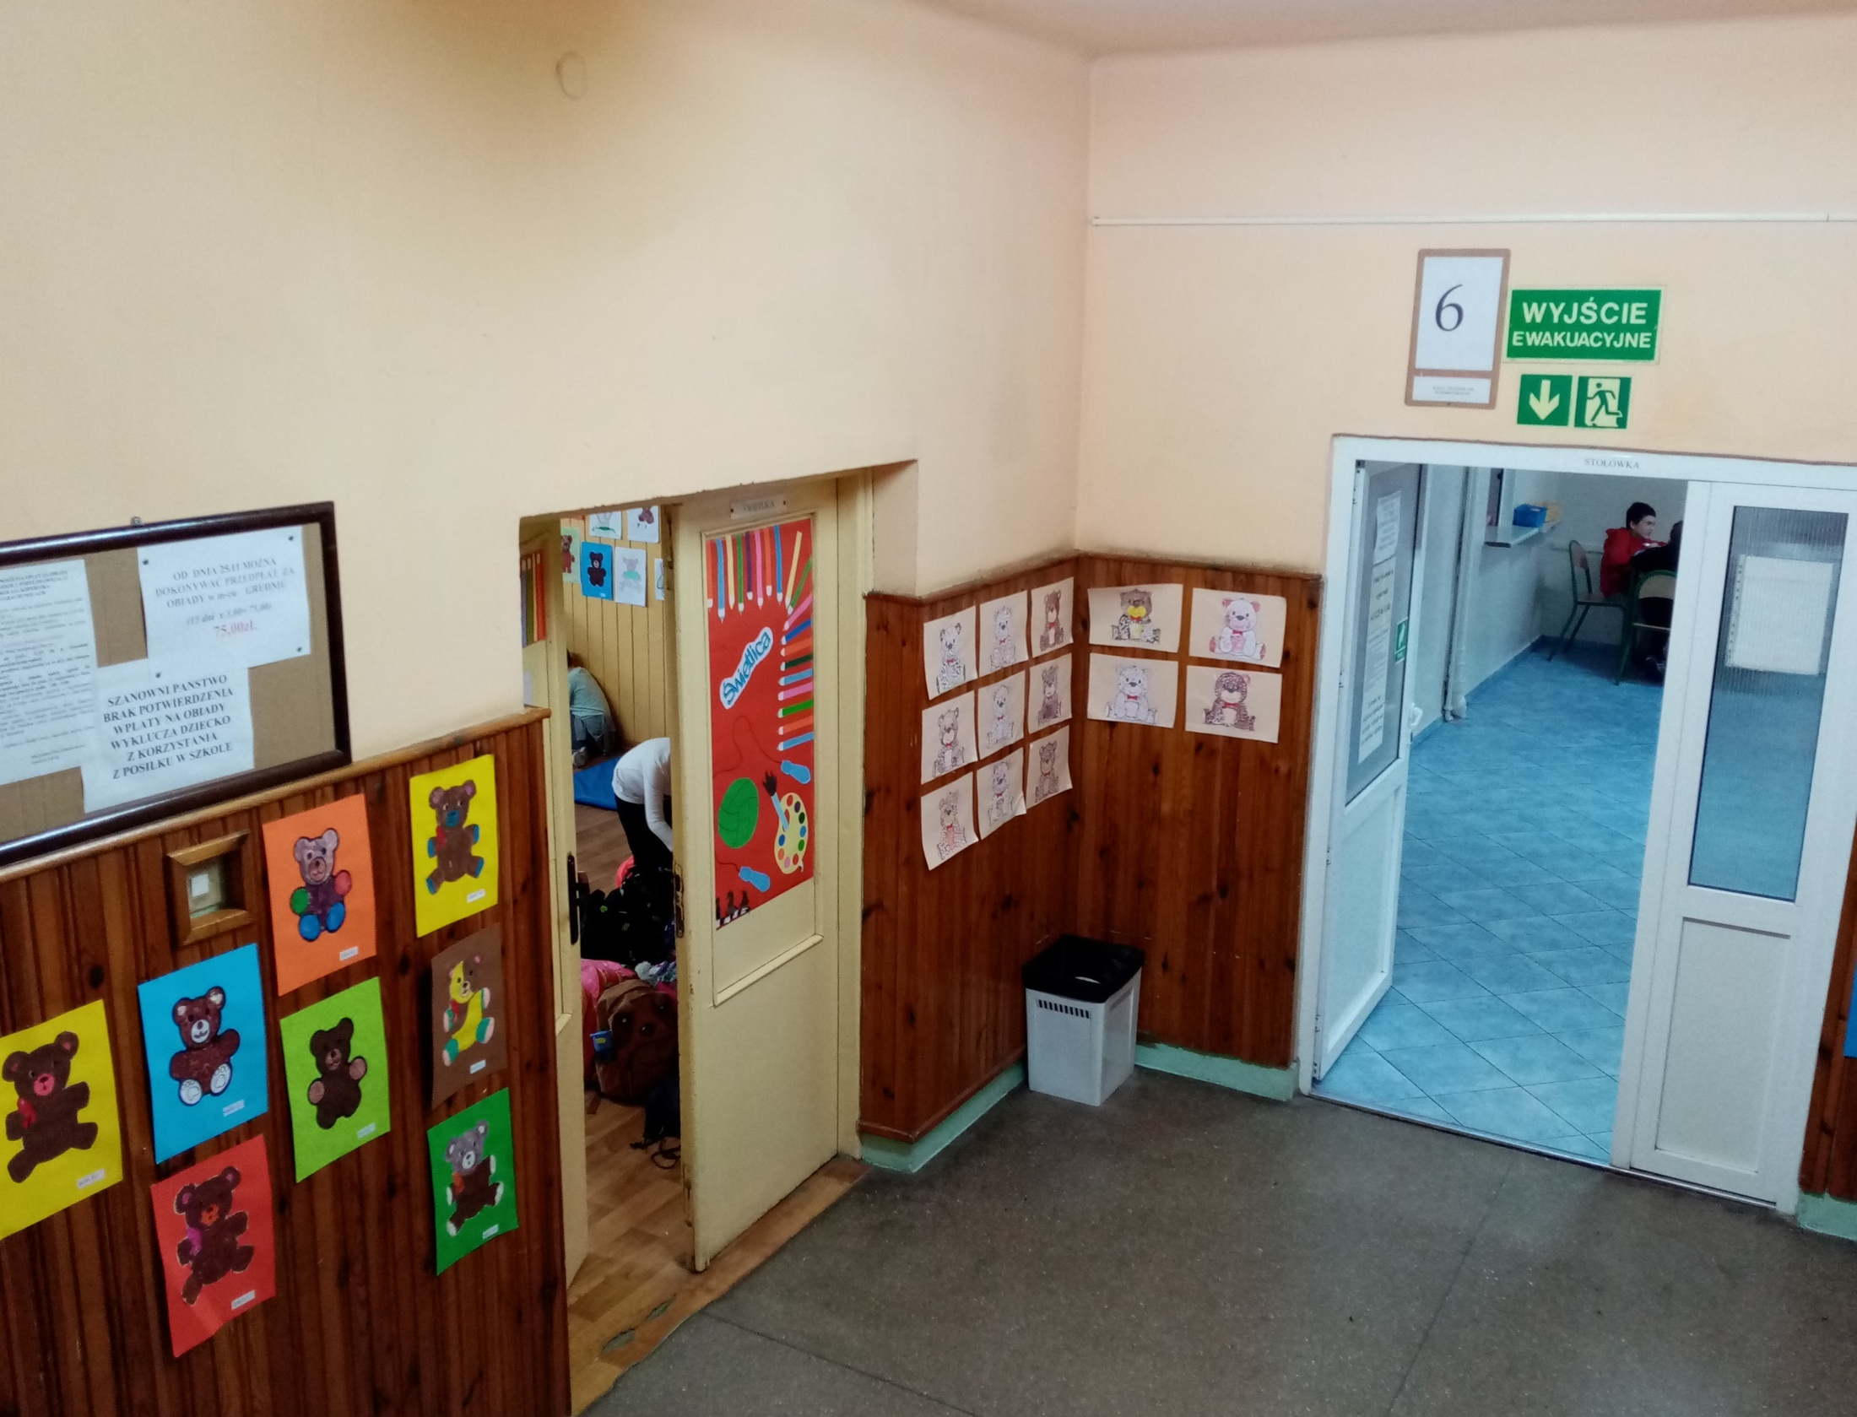
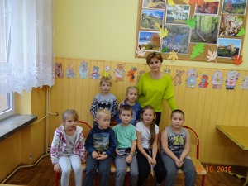
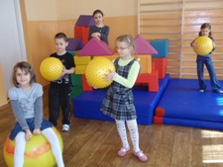
COMMON ROOM
AND
CANTEEN

Slide 10
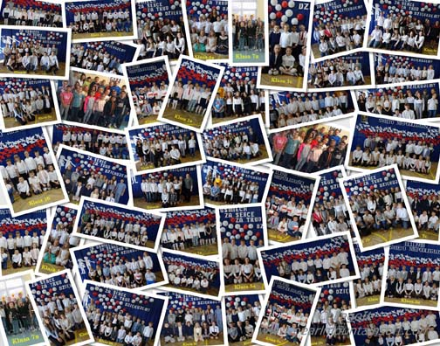
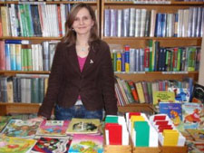
LIBRARY

Slide 11
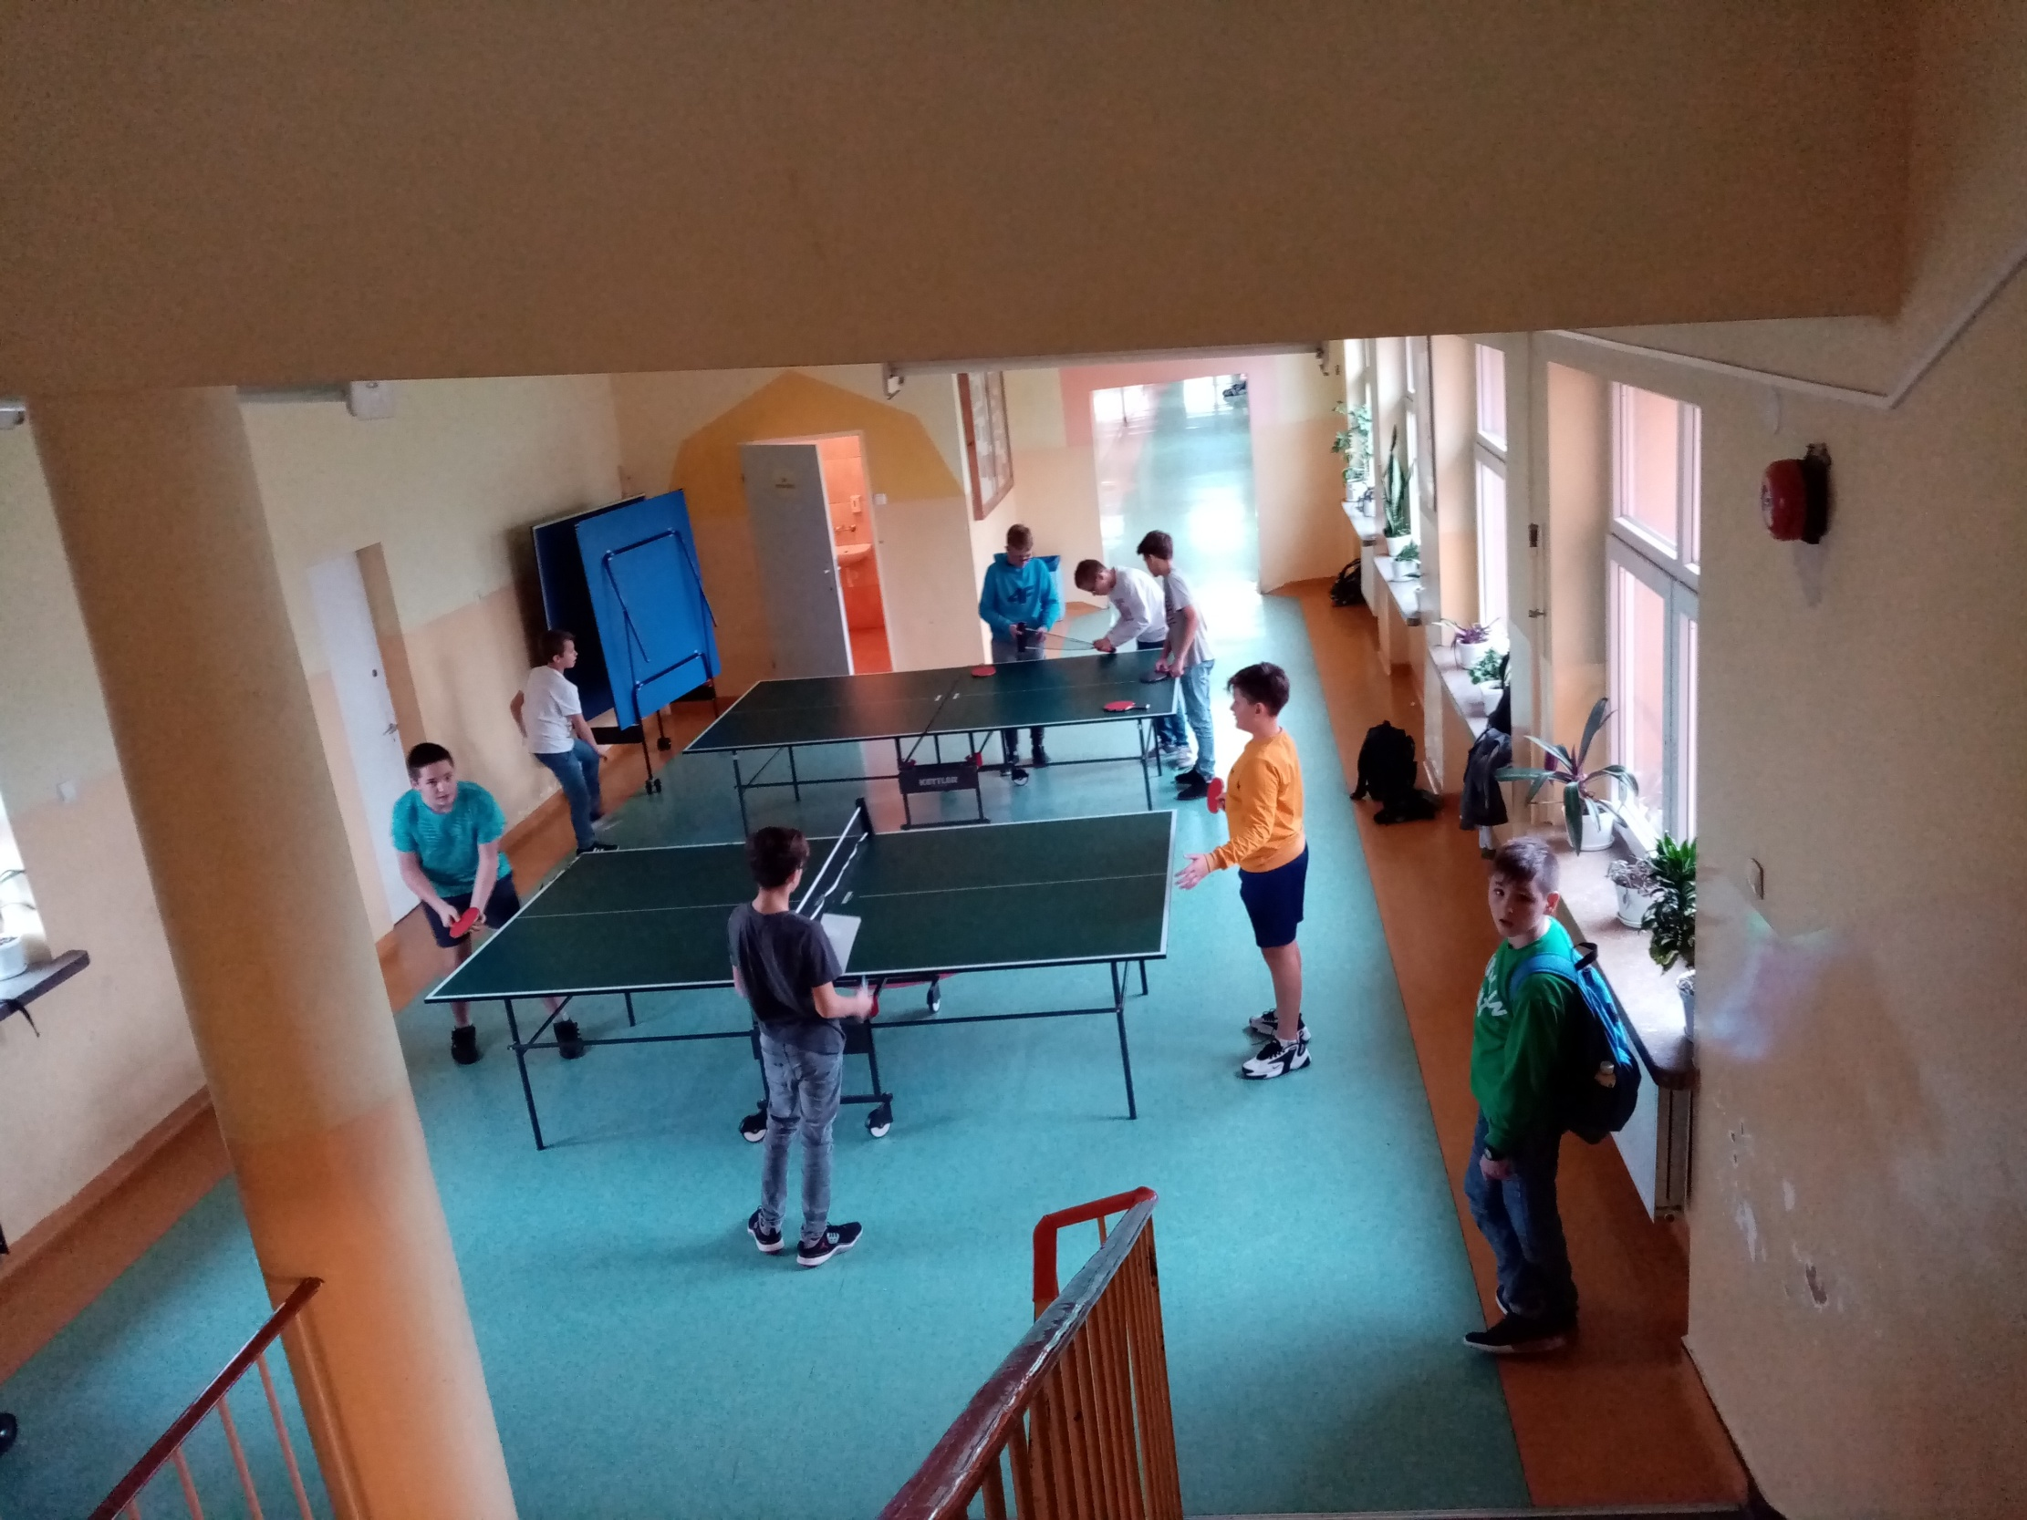
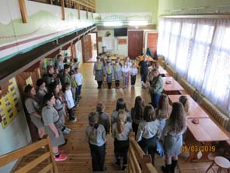
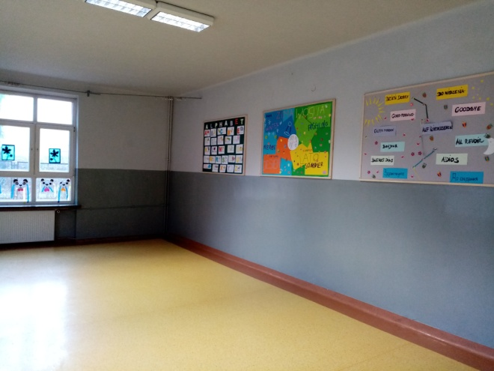
CORRIDORS

Slide 12
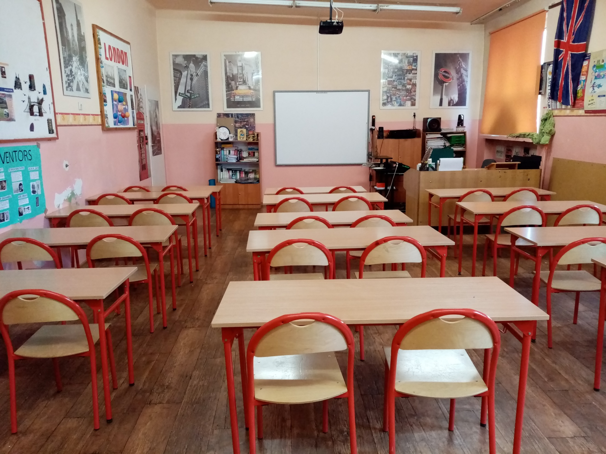
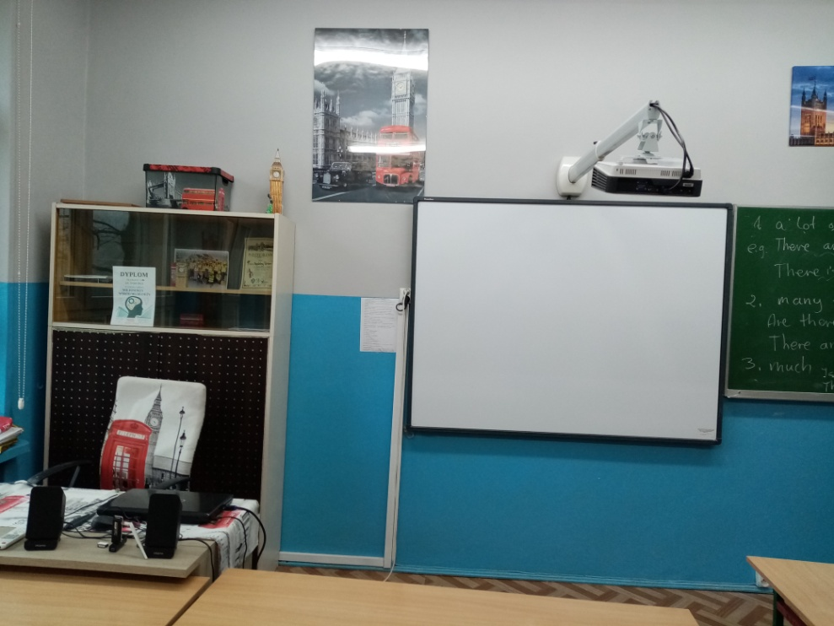
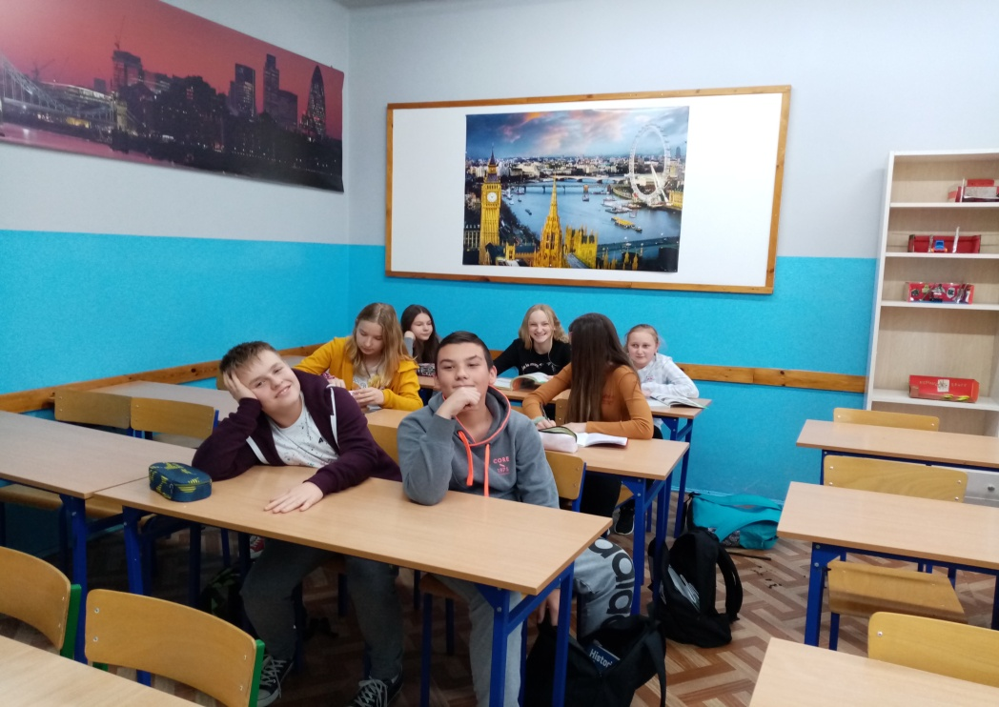
ENGLISH CLASSROOMS

